Slide 1
2017-2018 Goal
Deb Shew

Slide 2
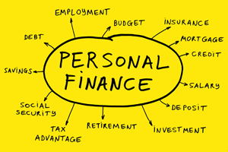
SLO Goal
90% of the students enrolled in Personal Finance 2nd Semester will elect to sign up for the Transcripted Credit (dual credit) opportunity through CVTC
Out of the 90%, 85% of students will successfully receive the two (2) credits from CVTC by earning a “C” or better at the completion of the class (73-76% per CVTC grading scale)

Slide 3
SLO Goal Outcome
100 % of the students enrolled in the Transcripted Credit opportunity
91.3% Success Rate
21 out of 23 students earned the two elective credits
Other two students passed the class; did not obtain transcripted credit; grade below 73%

Slide 4
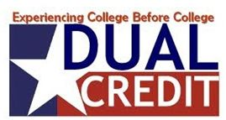
Why did I choose this SLO?
Personal Finance is a graduation requirement for Fall Creek
https://www.cnbc.com/video/3000489761
Is now a law in Wisconsin since January 2018 – must be taught K-12
Dual enrollment students are more likely to finish high school, enroll in a postsecondary institution, and experience greater postsecondary success
https://ccrc.tc.columbia.edu/dual-enrollment.html
WI vs. USA: High School Dual Enrollment Pathways into College

Slide 5
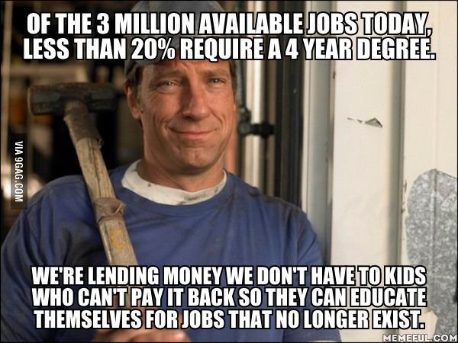
Benefits of Earning College Credits in High School
Save money $$$$$
Over $1000 per credit at four-year university to less than $150 at a two-year college
Overall average cost of about $600 per credit
Finish on time
Hard to finish in two and four years
Ease into college studies
Rigor, time management
Improve college admission chances
Competition
Shows strong abilities, initiative, and good planning

Slide 6
Student Success in the New Economy
Balance between education and workforce
University degree doesn’t necessarily prepare a person for employment
Education alone does not guarantee one’s income level potential
In 2018, Harvard predicts only 33% of all jobs will require a four-year degree or more, while the majority will be middle-skilled jobs requiring technical skills and training at the credential or Associates’ Degree level
1:2:7 – for every occupation that requires a master’s degree or more, two professional jobs require a university degree and there are over half a dozen jobs requiring a one-year certificate of 2-year degree
Dr. Kevin Fleming

